Slide 1

Sigurnost računala i podataka
Mario Čagalj
Sveučilište u Splitu
24.1.2012.

Slide 2
Denial of Service (DoS) Attacks
Computer Security: Principles and Practice
by William Stallings and Lawrie Brown
Produced by Mario Čagalj

Slide 3
Introduction: What is DoS?
DoS attack is an attempt (malicious or selfish) by an attacker to cause a victim to deny service to its customers
  DoS is an action that prevents the authorized use of networks, systems, or applications by exhausting resources such as CPU, memory, bandwidtch, and disk space
Categories of resources that could be attacked
  Network bandwidth
    Related to the capacity of network links connecting a server to the wider Internet
  System resources
    Overloading/crashing network handling software (e.g., SYN spoofing,
    ping-of-death – a “huge” ping packet)
  Application resources
    Overloading the capabilities of a web server application (e.g., valid querries)

Slide 4
Introduction: What is DoS?
Typical approaches to DoS attacks
  Exploit system design weaknesses (e.g., ping-of-death)
  Impose computationally intensive tasks on a victim (e.g., calculation of a secret Diffie-Hellman key, RSA operations)
  Flood the victim with a huge number of packets (requests)
    A DoS attack if it comes from (involves) a single computer
    Distributed DoS (DDoS) when multiple stations coordinate to flood the victim
      Independent of underlying network protocols
      Exploits the resource asymmetry between the Internet and the victim
      Perhaps one of the major threats to the stability of the Internet

Slide 5
Introduction: What is DoS?
DoS attacks can happen on any of the TCP/IP layers
  Physical layer (IEEE 802.11)
  Data-link layer (IEEE 802.11)
  Network layer (ARP, ICMP...)
  Transport layer (TCP, UDP...)
  Application layer (PGP, SSL, etc.)
Many DoS are regularly considered straightforward
  Radio jamming, flooding, etc.
  As a result there are very few sound DoS solutions
Also, DoS attacks are usually termed as “malicious attempts”
  However, often an attacker is driven by pure selfish interest
  Where there is interest, there is dedication and concentrated effort
Application
TCP/UDP
IP/ARP/ICMP
802.3/11 DLL
802.3/11 PHY

Slide 6
DoS Attacks at the Physical and Data Link Layer:
The Case of WLAN (IEEE 802.11)

Slide 7


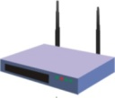
IEEE 802.11
Definiran za bežične LAN (WLAN)
Gdje se nalazi u OSI modelu?
  Fizička razina
  Podatkovna razina (Media Access Control - MAC, sigurnost)
terminal
mobilno računalo
Ethernet mreža
pristupna točka
aplikacija
TCP
IP
802.11 MAC
802.11 PHY
aplikacija
TCP
IP
802.3 MAC
802.3 PHY
802.11 MAC | 802.3 MAC
802.11 PHY | 802.3 PHY

Slide 8
IEEE 802.11b/g: fizička razina
2.4 GHz (2.4–2.4835 GHz) 14 frekvencijskih kanala
  Centralne frekvencije kanala su pomaknute za 5 MHz
  13 se koristi u EU, 11 US
Koristi tehniku raspršenog spektra (Spred Spectrum - SS)
  Poskakivanje frekvencije (Frequency Hopping SS)
  Pseudoslučajni raspršeni spektar (Direct Sequence SS)
Kodiranje i modulacijske sheme odredjuju max. komunikacijske brzine (1, 2, 5, 11, 54Mbps, ...)
  802.11b na 11Mbps
    Complementary Code Keying (CCK)
    Differential Quadrature Phase Shift Keying (DQPSK)
  802.11g na 54Mbps
    Orthogonal Frequency Division Multiplexing (OFDM)

Slide 9
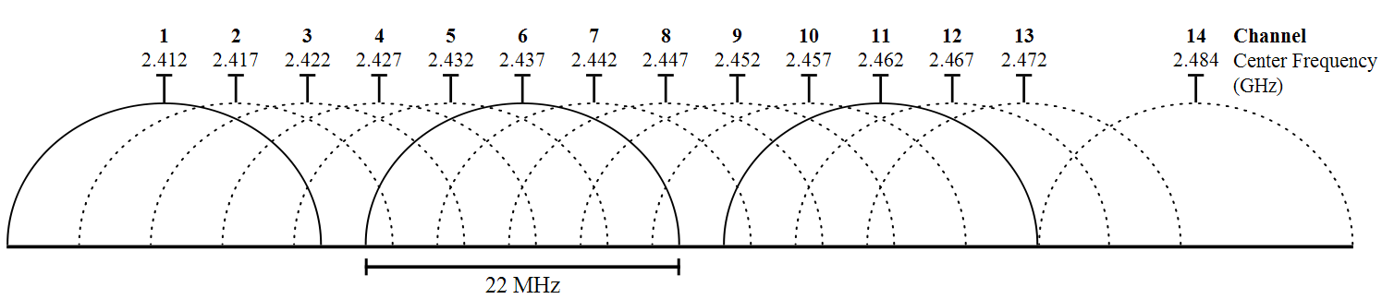

Komunikacija izmedju AP i klijenta
channel 6
AP komunicira sa klijentom koristeci jedan kanal (npr. channel 6)
Samo jedan klijent komunicira sa AP u svakom trenutku
Znacajna interferencija preostaje na kanalu
  Od susjednih kanala
  Od okolisa u kojem se nalazi AP

Slide 10


DoS Attacks at the Physical Layer
DoS napadi ometanjem radio singala (radio jamming)
  Napadač emitira radio signal u frekvencijskom podrucju aktivnog kanala (npr., kanal 6 u podrucju 2.437 GHz +/- 10MHz)
  Da bi pojačao efekt ometanja, napadač koristi usmjeravajuće antene
IEEE 802.11 ne pruža zaštitu protiv radio ometanja
  DoS putem radio ometanja često se zanemaruje (pogrešno)
zatvorena
prostorija
napadač

Slide 11


IEEE 802.11b Data Link Layer
MAC (Media Access Control) arbitrira pristup zajednickom kanalu izmedju veceg broja bezicnih stanica
Carrier Sense Multiple Access with Collision Avoidance (CSMA/CA) paradigma
  Prije transmitiranja paketa na kanalu, mobilno računalo provjerava da li je kanal već “zauzet” (npr., od strane drugog računala)
  Izbjegavanje kolizija između paketa dva ili više računala putem randomiziranog “back-off” mehanizma
Računalo A
AP
Računalo B

Slide 12

IEEE 802.11b Data Link Layer
DIFS
DIFS
A zamrzava brojač
i odgađa slanje
NAV
Računalo A
Backoff
Backoff
SIFS
SIFS
Pristupna točka
ACK
ACK
NAV
Podaci
Računalo B
Backoff
vrijeme
B odgađa slanje
Notacija:
  DIFS: Distributed Inter-Frame Spacing
  SIFS: Short Inter-Frame Spacing
  Backoff: slučajan broj iz skupa {1,2,…, CW} – izražava se u vremenskim intervalima
  CW: maksimalno trajanje Backoff-a
  NAV: Network Allocation Vector

Slide 13


Link Layer DoS Attacks: System Weakness
DIFS
DIFS
Računalo A
Backoff
Backoff
SIFS
SIFS
Pristupna točka
ACK
ACK
NAV
NAV
Računalo B
Backoff
Backoff
vrijeme
B zamrzava brojač
i odgađa slanje
B zamrzava brojač
i odgađa slanje
Notacija:
  DIFS: Distributed Inter-Frame Spacing
  SIFS: Short Inter-Frame Spacing
  Backoff: slučajan broj iz skupa {1,2,…, CW}
  CW: maksimalno trajanje Backoff-a
  NAV: Network Allocation Vector

Slide 14

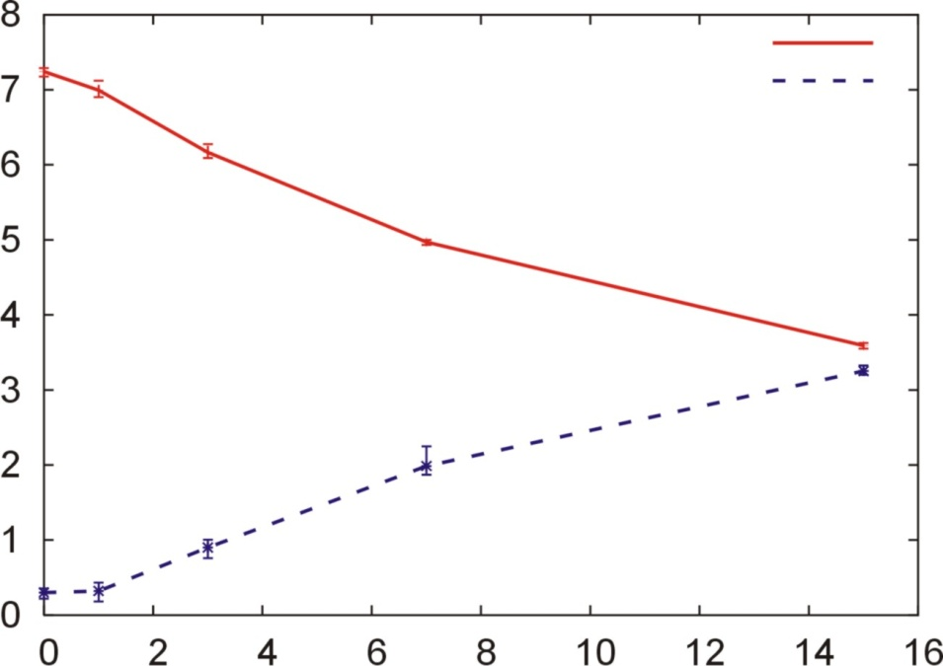
Link Layer DoS Attacks: Implications
Primjer: manipulacija Backoff vrijednostima
  Jednostavna implementacija (jedna linija koda kod bežičnih adaptera koji koriste Atheros radio čipove, npr. Proxim Orinoco - )
  IEEE 802.11e sa QoS (Quality of Service) podrškom omogućava manipulaciju Backoff-a, DIFS-a, SIFS-a!
Računalo A
AP
Računalo B
UDP
Računalo A
Brzina komunikacije [Mbps]
UDP
Računalo B
CW (Backoff) računala A

Slide 15
Flooding-Based DoS Attacks

Slide 16
Flooding-Based DoS Attacks: Intro
Flood the victim with a huge number of packets (requests)
  A DoS attack if it comes from (involves) a single computer
  Distributed DoS (DDoS) when multiple stations coordinate to flood the victim
    Independent of underlying network protocols
    Exploits the resource asymmetry between the Internet and the victim
    Perhaps one of the major threats to the stability of the Internet

Slide 17

Flooding-Based DoS Attacks
Generally, there are two types of flooding attacks
  Direct attacks
  Reflector attacks
Attacker
Attacker
TCP SYNC, ICMP,
UDP, ...
Src IP: Victim
Dst IP: Reflector
Reflector
TCP SYNC, ICMP,
UDP, ...
Src IP: Reflector
Dst IP: Victim
Reflector
TCP SYNC-ACK,
TCP RST,
ICMP,UDP...
TCP SYNC-ACK,
TCP-RST,
ICMP,UDP...
Victim
Victim
Direct attack
Reflector attack

Slide 18


Smurf DoS Attack
1 x ICMP Echo request
Src IP: Victim
Dst IP: Bcast address
3 x ICMP Echo reply
Dst IP: Victim
Victim
Attacker
Gateway
Amplification effect
Victim flooded with ICMP “Echo-reply” packets
Attacker sends numerous ICMP “Echo-request” packets to the broadcast address of many subnets
  ICMP “Echo-request” packets contain the victim’s address as the source IP address
Machines on the subnets respond by sending ICMP packets to the victim
  Recall: ping utility implemented using the ICMP “request” and “reply”

Slide 19
Some Reflector Attack Methods [Chang’02]
 | Packets sent by an attacker to a reflector (with a victim’s addressas the source address) | Packets sent by the reflector to the victim in response
Smurf | ICMP echo queries to a subnet-directed broadcast address | ICMP echo replies
SYN flooding | TCP SYN packets to public TCP servers (e.g., Web servers) | TCP SYN-ACK packets
RST flooding | TCP packets to nonlistening TCP ports | TCP RST packets
ICMP flooding | ICMP queries (usually echo queries) UDP packets to nonlistening UDP ports IP packets with low TTL values | ICMP replies (usually echo replies) ICMP port unreachable messages ICMP time exceeded messages
DNS reply flooding | DNS (reqursive) queries to DNS servers | DNS relies (usually much larger than DNS queries)

Slide 20
SYN Flooding Attack
TCP handshake
Server waits Client’s ACK and retransmits the SYN-ACK several times before giving up (half-open connections can quickly consume all the memory allocated for pending connections)
Client
Server
Wait
SeqC=3000, SYN=1
SeqS=5000, SYN=1,
AckA=3001, ACK=1
Store data
SeqC=3001,
AckB=5001, ACK=1
Wait (retransmit the SYN-ACK
packets until timeout)
TCP connection established
time

Slide 21
SYN Flooding Attack contd.
Low flooding rate attack (small number of attacking machines)
Client
Server
Wait
SYN 1 (fake Src IP 1)
SYN 2 (fake Src IP 2)
SYN 3 (fake Src IP 3)
SYN 4 (fake Src IP 4)
Store data
Wait (retransmit the SYN-ACK
packets until timeout)
time
Backlog queue fills up with half-open connections.

Slide 22
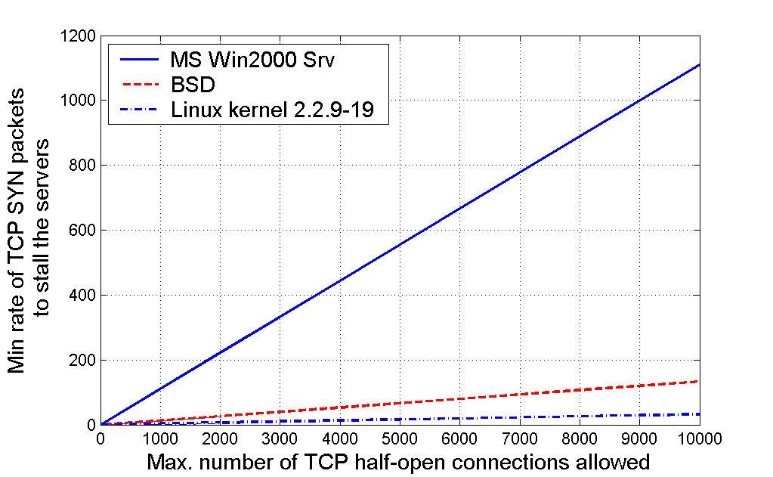
How Many Attack Packets are Needed?
Each half-open connection is held for a certain amount of time before giving up [Chang’02]
  Windows system ~ 9 s (2 retransmissions), BSD system ~ 75 s (3-4 retransmissions), Linux ~ 309 s (up to 7 retransmissions)
If each SYN packet is 84 bytes long
  56 kb/s connection sufficient
  to stall Linux and BSD servers
  that admit up to 6,000
  half-open TCP connections
  1 Mb/s connection sufficient
  to stall all three servers
  that admit up to 10,000 h-o. c.
Jamming T1 link
  Capacity 1,544 Mb/s
  Direct ICMP ping requires around 5000 pckts/s

Slide 23
Low Rate SYN Countermeasures
Straightforward (and inadequate)
  Increase the backlog queue size
  Decrease the time that a server holds half-open connection
SYN Cookies
  Sever does not store any state until the client passes the “random” challenge (returns a random value carried by the server’s cookie)
    If attacker spoofs the source IP, it cannot receive the SYN Cookie
  Better than the first solution

Slide 24
Direct Distributed DoS (DDoS)
Attacker coordinates multiple “zombie” machines to simultaneously flood a target machine or the network uplink
  High flooding rate attacks (many stations involved)
Direct DDoS
  The army of the attacker consists of
  “master zombies” and “slave zombies”
  Both classes are compromised machines
  (infected by malicious code)
  The attacker coordinates masters
  The masters trigger and coordinate
  slave zombies
  Zombies flood the victim’s
  system (e.g., SYN flood)
Spoofed source IP addresses are used
  Attacker wants to hide IDs of zombies
  so that victim cannot trace attack back to them
  Attacker wants to discourage any attempt of
  the victim to filter out the malicious traffic
Attacker
Masters
Slaves
Victim

Slide 25
Reflector DDoS
Attacker
The army of the attacker consists of
  Master zombies, slave zombies and
  reflectors
Slave zombies are led by master
zombies to send a stream of packets
with the victim’s IP address as the
source IP address to other
uninfected (non-compromised)
machines (reflectors)
  Reflectors generate messages
  for the victim in response to
  messages from the slave
  zombies
  E.g., if SYN flood is used,
  reflectors are victims themselves
    But the situation is not that severe as the
    direct attack
Masters
Slaves
Reflectors
Victim

Slide 26
Reflector DDoS contd.
Some differences wrt. direct DDoS attacks
  A reflector attack requires a set of predetermined reflectors (DNS servers, HTTP servers, routers)
  The magnitude of the attack is based on the size of the reflector pool (instead of the zombie pool)
  The reflectors could also be more dispersed on the Internet
    The attacker does not have to compromise such machines
  The reflected packets are normal packets with legitimate source addresses and packet types
    Harder to filter such packets based on address spoofing or other route-based mechanisms

Slide 27
Examples: DDoS Based on SYN Flood
Hypothetical
  Assume 10,000 zombies or 10,000 reflectors
  Each sends 100 SYN per second
  Each SYN packet is 100 bytes long
  In total, they generate ~ 1 Gb/s
    Could easily saturate the victim’s incoming link
    The only way to prevent the link bandwidth from being exhausted it to increase the size of the network pipe
MS Blaster worm in 2003
  Starts the DoS on Aug 16th and performs SYN flood DoS attack against “windowsupdate.com” (floods port 80)
  50 HTTP packets per second
  Packets are 40 bytes in length
  Random IP source addresses a.b.x.y (a-b from host, x-y random)
  In response, Microsoft changes “windowsupdate.com” to “windowsupdate.microsoft.com”
BetCris.com in 2003 (online extortion threat)

Slide 28
DNS Amplification Attack
Classic DNS protocol
  60 byte UDP request packet
  Maximum 512 byte UDP response
Recently, the DNS protocol extedned (IPv6, security)
  Allow larger responses of over 4000 bytes
Attacker can exploit this and achieve significant gain
  Invests 60 bytes to get over 4000 bytes for “free”
  Amplification effect
Turning this into an attack
  Attacker creates a series of DNS “small” requests using the spoofed source IP address of the victim
  The victim gets flooded with “large” DNS responses

Slide 29
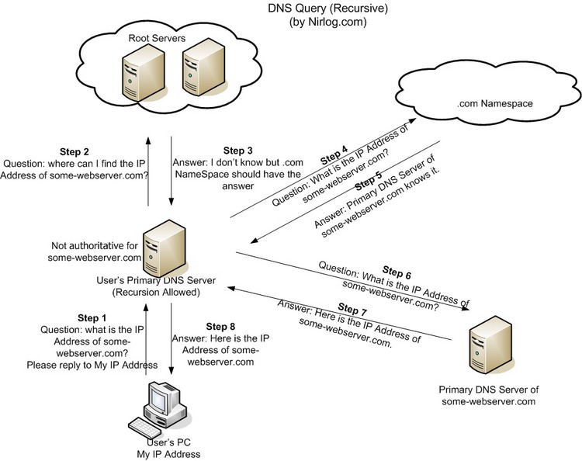
DNS Amplification Attack
Recursive DNS query

Slide 30
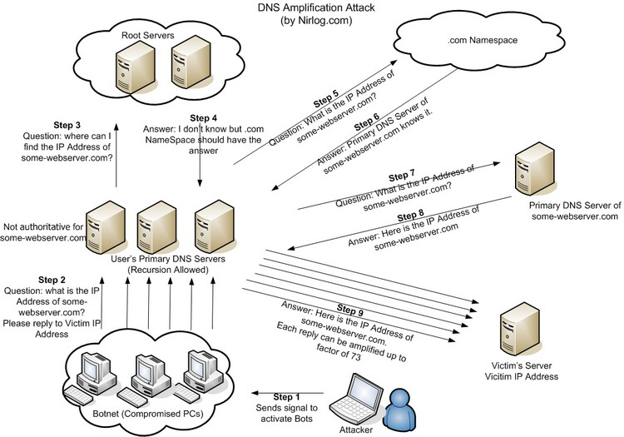
DNS Amplification Attack contd.

Slide 31

Upper Layer DoS Attacks
Transport layer (e.g., SSL/TLS)
  RSA-encrypt speed approx. 10 x RSA-decrypt speed (amplification effect)
Application layer
  eBanking service locks an account after 3 consecutive failed login attempts
    An attacker can easily lock down a number of such accounts
  Send HTTP request for some large PPT file (e.g., SRS webpage :-)
    Amplification effect (easy work for client, hard work for server)
Client
Server
Client Hello
Server Hello, Certificate (Public Key)
RSA encryption
Client sends PREMASTER KEY
encrypted with server’s Public Key
RSA decryption
Create SESSION KEY from PREMASTER KEY

Slide 32
DoS Countermeasures
Partially adopted from Dan Boneh’s 2006 lecture notes

Slide 33
General Countermeasures
Attack prevention and preemption (before the attack)
  Enable the victim to endure attack attempts without denying service to other clients
  Backup resources on demand, enforce policies for resource consumption
  Scan hosts for the presence of malware such as zombies or worms
Attack detection and filtering (during the attack)
  Attempt to detect the attack as it begins and respond immediately
  Detection involves looking for suspicious patterns of behavior
  Response involves filtering out packets likely to be part of the attack (e.g., firewalls)
Attack source traceback and identification (during and after the attack)
  Try to identify the source of the attack as a fist step in preventing future attacks
  Does not prevent an ongoing attack

Slide 34


Client Puzzles
The main idea is to slow down the attacker by forcing him to commit considerable computational resources
  In the event of an attack, each connection request will be challenged with a relatively easy problem (“puzzle”)
  Only those connection requests that submit puzzle solution with the request will be “approved”
  Example: SSL/TLS “puzzle” [Dean and Stubblefield’01]
Client Hello
Client
Server
Server Hello
Client Hello
Server Hello, Certificate (Public Key)
Certificate
RSA encryption
Client sends PREMASTER KEY
encrypted with server’s Public Key
RSA decryption
Puzzle Request
Create SESSION KEY from PREMASTER KEY
Puzzle Reply
Check puzzle solution
before RSA decrypt
Server Done

Slide 35
Client Puzzles contd.
Simple puzzle
  For a preimage resistant hash function h(x), a client puzzle is the triple
  (n, x’, h(x))
  where x’ is x with n lowest bits set to 0.
  The solution to the puzzle is the full value of x
  Because h(x) is preimage resistant, it takes, on average, 2^{n-1} calculations of h(x) for the client (attacker)
Generating and checking puzzles easy
  The server only needs to generate a random block of data and evaluate the hash function twice
Does not work with DoS attacks where the attacker saturates the victim's incoming link
  En route routers do not verify the validity of puzzles

Slide 36
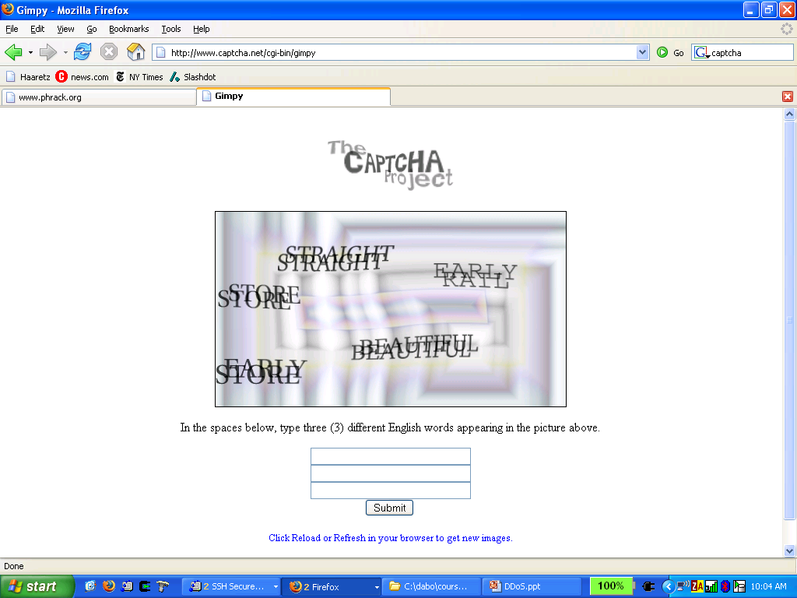
CAPTCHA
Completely Automated Public Turing test to tell Computers and Humans Apart
  Carnegie Mellon University
  Challenge-response test used to determine whether or not a user is human
  Computers are not able to solve tests of the following kind
Applies to application layer DoS
  Attacker cannot automate an attack whereby he locks out many eBanking accounts

Slide 37
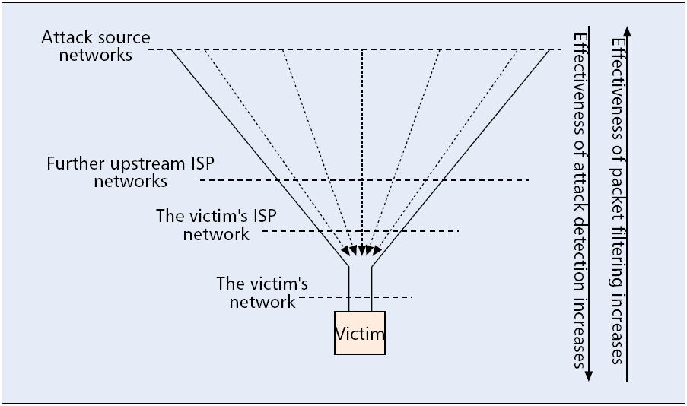
DDoS Attack Detection and Filtering
Detection – identifiying DDoS attacks or attack packets
Filtering – after identifying attack packet flows or packet, filtering responsible for classifying and dropping them
  The effectiveness depends on false positive and false negative ratios
Detect-and-filter approach can be performed in four places on the paths between the victim and the attacking machines

Slide 38
Network Ingress Filtering (RFC 2827)
Preventing DDoS attacks which employ IP address spoofing
  An input traffic filter on the ingress (input) link of the router restricts traffic to allow only traffic originating from source addresses within the 204.69.207.0/24 prefix, and prohibits the attacker from using source addresses outside of this prefix range. [RFC 2827]
All ISP must do this (global trust)
  If only 10% do not implement ingress filtering, there is no defense
ISP
Internet
router
Attacker
204.69.207.0/24

Slide 39
At a Victim’s Upstream ISP Network
Frequently, upstream ISP is requested (through telephone calls) by a DDoS victim to filter attack packets
  Before doing this, attack packets have to be identified to avoid dropping legitimate packets
  Ideally, a victim network may send to an upstream ISP router an intrusion alert message, which specifies the signature of the attack packet flows
  These alert messages may be pushed further upstream so that the upstream ISPs are notified to filter those packets matched in the signature
  This approach is effective only if ISP networks are willing to cooperate and to install packet filters upon receiving intrusion alerts
    Seldom the case
    Many issues – how to trust alert messages?

Slide 40
Source Traceback
IP traceback refers to the problem (solution) of identifying the actual source of any packet sent across the Internet without relying on the source information in the packet
Two general approaches
  Routers record information about packets they have seen for later traceback requests
  Routers send additional information about the packets they have seen to the packets’ destinations (within the packets or using other channels such as ICMP messages)
Infeasible to use IP traceback to stop on-going DDoS
  IP traceback could be very helpful in collecting evidence for post-attack law-enforcement
IP traceback is ineffective in reflector attacks

Slide 41
Simple Traceback Method
Write path into network packet
  Each router adds its own IP address to packet
  Victim reads path from packet
Problem:
  Requires space in packet
    Path can be long
    No extra fields in current IP format
      Changes to packet format too much to expect

Slide 42
Better Traceback Method
DDoS involves many packets on same path
Store one link in each packet
  Each router probabilistically
  stores own address
  Fixed space regardless
  of the path length
Packet marking algorithm
  E.g., edge sampling
A₁
A₂
A₃
A₄
A₅
R₆
R₇
R₈
R₉
R₁₀
R₁₂
V

Slide 43
Edge Sampling
Data fields written to packet:
  Edge: start and end IP addresses
  Distance: number of hops since edge stored
Marking procedure for router R
  if coin turns up heads (with probability p) then
  write R into start address
  write 0 into distance field
  else
  if distance == 0 write R into end field
  increment distance field

Slide 44
Edge Sampling contd.
Packet received
  R₁ receives packet from source or another router
  Packet contains space for start (S), end (E), distance (D)
packet
S
E
D
R₁
R₂
R₃

Slide 45

Edge Sampling contd.
Begin writing edge
  R₁ chooses to write start of edge
  Sets distance to 0
R₁
R₂
R₃

Slide 46
Edge Sampling contd.
Finish writing edge
  R₂ chooses not to overwrite edge
  Distance is 0
    Write end of edge, increment distance to 1
packet
R₁
R₂
1
R₁
R₂
R₃

Slide 47
Edge Sampling contd.
Increment distance
  R₃ chooses not to overwrite edge
  Distance > 0
    Increment distance to 2
packet
R₁
R₂
2
R₁
R₂
R₃

Slide 48
Path Reconstruction
Extract information from attack packets
Build graph rooted at victim
  Each (start,end,distance) tuple provides an edge
The number of packets needed to reconstruct path
  p is marking probability
  d is length of path
A₁
A₂
A₃
A₄
A₅
R₆
R₇
R₈
R₉
R₁₀
  ln(d)
  p(1-p)^{d-1}
R₁₂
V

Slide 49
Many Traceback Proposals
Advanced and Authenticated Marking Schemes for IP Traceback
  Song, Perrig. IEEE Infocomm ’01
  Reduces noisy data and time to reconstruct paths
An algebraic approach to IP traceback
  Stubblefield, Dean, Franklin. NDSS ’02
Hash-Based IP Traceback
  Snoeren, Partridge, Sanchez, Jones, Tchakountio,
  Kent, Strayer. SIGCOMM ‘01

Slide 50
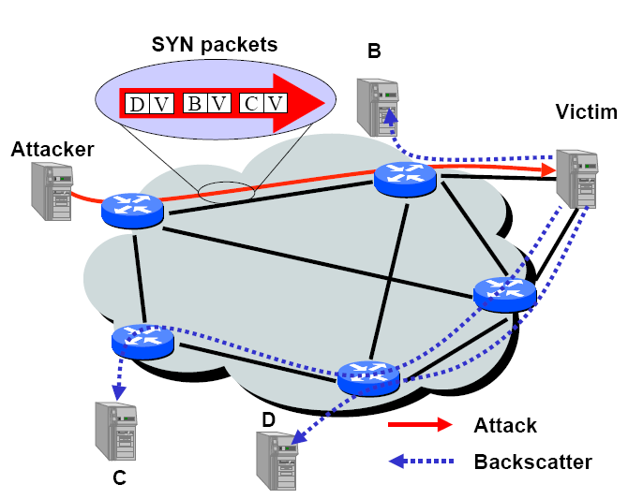
Inferring Internet DoS Activity [Moore’01]
Backscatter analysis
  Provides an estimate of worldwide denial-of-service activity
  In 2001 observed more than 12,000 attacks against more than 5,000 distinct targets

